Slide 1
Project Presentation
Societal Project - 01BMBAR23364
Effects of Traffic on Street Vendors
Group Members
Atharwa Malawade (23MBAR199)
Sahil Uppin (23MBAR166)
Prajwal Alfanso (23MBAR181)
Raj Jain (23MBAR151)
Manav Dutta (23MBAR168)
Project Guide:
Dr. Prem Kumar
Assistant Professor, Department of Management

Slide 2
INTRODUCTION
This study identifies the effects of traffic on the street vendors
The study found that the vendors are affected health-wise due to daily exposure to the pollution and noise created by the traffic.
The lack of foresight in traffic planning regarding street vending leads to many problems with the flow of traffic. This leads to higher chances of accidents, traffic disruptions
Street vendors also cannot easily acquire loans or other forms of financing for personal or work-related needs as street vending is not formalized and lack of support from both governmental and non-governmental institutions.

Slide 3
LITERATURE REVIEW...
Bhowmik (2006):
Focus: Social security measures for street vendors.
Key Findings: Emphasizes the need for policies that protect street vendors’ livelihoods and ensure their inclusion in urban economies. Highlights the positive impacts of social security policies on vendors’ well-being but also points out gaps and challenges in implementation.
Cerna & Cerny (2004):
Focus: Traffic flow and congestion formation.
Key Findings: Discusses the theoretical aspects of traffic flow and the role of driver perception and response time in congestion. Suggests that improving driver response times and optimizing traffic flow can mitigate congestion on urban roads.
Cobbinah & Finn (2024):
Focus: Inclusive transport planning.
Key Findings: Argues for a “streets for all” policy that includes multiple street activities and addresses biases in urban transport planning. Emphasizes creating inclusive transport systems that consider the needs of all road users, promoting spatial justice and progressive urban development.

Slide 4
LITERATURE REVIEW...
4.Alkaissi & Kamoona (2021):
Focus: Roadside friction and traffic flow.
Key Findings: Examines how roadside activities, including street vending, affect traffic flow and road capacity. Highlights the need to include roadside friction elements in traffic-related studies for proper urban road planning.
5.Karda et al. (2017):
Focus: Impact of street vendors on road performance.
Key Findings: Measures the impact of street vendors on travel speed and road capacity. Suggests providing designated facilities for street vendors to minimize traffic impact and ensure smoother traffic flow and better road performance.
6.Timalsina (2007):
Focus: Rural-urban migration and street vending.
Key Findings: Explores the dynamics of migration driven by socio-economic disparities and its impact on livelihoods in the urban informal sector. Highlights the significant employment opportunities and income provided by street vending, as well as the challenges faced by vendors, including harassment and competition for space.

Slide 5
OBJECTIVES OF THE STUDY
To assess the impact of traffic congestion on the daily earnings of street vendors in urban areas of India.
To analyse the coping strategies employed by street vendors to mitigate the negative effects of traffic congestion.
To evaluate the role of local government policies in addressing the challenges faced by street vendors due to traffic congestion.

Slide 6
RESEARCH METHODOLOGY
Research Component | Details
Type of Research | Exploratory Research This type of research is suitable for gaining insights into the relatively under-explored area of how traffic affects street vendors.
Research Design | Mixed-Methods Design (Qualitative and Quantitative)
Data Collection | - Interviews (food vendors, merchandise sellers) - Focus groups (vendors) - Observations (Field observations to record traffic patterns and vendor activities.)
Data Analysis | Percentage Analysis, Frequency Analysis, Charts
Sampling | Stratified Random Sampling

Slide 7
RESULTS / FINDINGS
Majority of the Street vendors believed that the vehicle traffic did not have much impact on their business as compared to the pedestrian traffic.
Majority of vendors who did not deal in daily essentials reported that most of their sales occurred in the weekends. Generally, the sales during the holidays, festivals and weekends were more than 50% than on a regular weekday.
Majority of the vendors reported that heavy traffic impeded the flow of pedestrians but also gave an opportunity to sell to the vehicle riders. Traffic jams and congestions causes them to adapt to it and change their usual operations
Majority of vendors who sold luxury items, jewellery and cosmetics voted at slight change in operational cost or No Change. Most vendors who operated fast food stands and other snacks or beverage stands reported greater change in operational and transport costs.
Most vendors who sell products and items work more than 8 hours a day, while those dealing in snacks, fast foods etc work 6 hours or less. The reason is that majority of their sales occur in the evenings. This doesn’t take their preparation time into account

Slide 8
RESULTS / FINDINGS
Majority of the street vendors reported having faced health issues due to pollution or traffic. Age as well as the time period of their time spent in street vending contributed to the effects.
Majority of the vendors have access to public healthcare from government although access to these is unrelated to their work, but rather due to their economic status. Very few vendors reported being able to afford private healthcare without having to borrow money and going into debt.
While majority of the vendors did not personally face legal problems with authorities, there were quite a few that did. There is a sense of general distrust and fear when regarding the local authorities. Most vendors refused to provide their pictures or recordings of their interviews as they feared legal repercussions.
Other than a few designated places where you can rent a place in public to sell your wares, majority of the vendors reported that there is a lack of support or regulations as to where stalls can be set up in public. Lack of urban planning fails to consider street vending when it comes to city infrastructure.
Majority of the street vendors reported issues with the law enforcement forcing them to move or change places, especially from the traffic police. While they are left alone most of the time, and formal complaints aren’t made, the law enforcement do cause some disruptions to the street vendors

Slide 9
RESULTS / FINDINGS
While the Indian government did pass the Street vending Act giving street vendors some protections and rights, there is no governmental programs to support the street vendors specifically. Lack of implementation on the ground is what causes this.
Street Vendors reported that there is no financial support provided to street vendors from the government. Most did receive financial and material support through unrelated policies and during the COVID lockdowns
Majority of the street vendors are not part of any formal association or union. Most of their internal dealings is done through mutual trust and respect.
Majority of the street vendors face extreme difficulty in securing loans for their personal or work-related needs and depend on informal sources such as relatives, loan sharks etc. The main reason is the lack of paper trail or proof of income as it is an informal economy.

Slide 10
SUGGESTIONS
Dedicated Vending Zones and Better Infrastructure
Health and Safety Measures
Increased Access to Legal Protections and Support
Traffic Management and Vendor Integration
Use of Technology and Data for Planning
Public Awareness and Sensitization Campaigns

Slide 11
CONCLUSION
Finally, the study recommends addressing the broad effects of traffic congestion on street vendors, highlighting the economic and health challenges they face. As essential players in the informal economy, street vendors meet local people’s needs for basic, low-cost goods and services. However, their livelihoods are often shaped by urban traffic dynamics and the lack of formal recognition, forcing them to operate under highly constrained conditions while being exposed to pollution and safety risks.
Tackling these challenges requires a multi-level approach: establishing dedicated vending zones, enhancing health and safety for all, strengthening legal protections, and ensuring that vendors are integrated into urban traffic management plans. Technology can also play a role by tracking traffic and pedestrian patterns, complemented by public awareness campaigns that help shift perceptions of street vendors from traffic obstacles to valuable community assets. By fostering an inclusive urban framework, Bangalore can support street vendors while also improving transportation efficiency. This balance of economic inclusivity and urban planning will strengthen the city’s social and economic fabric, laying the groundwork for sustainable and equitable urban growth.

Slide 12
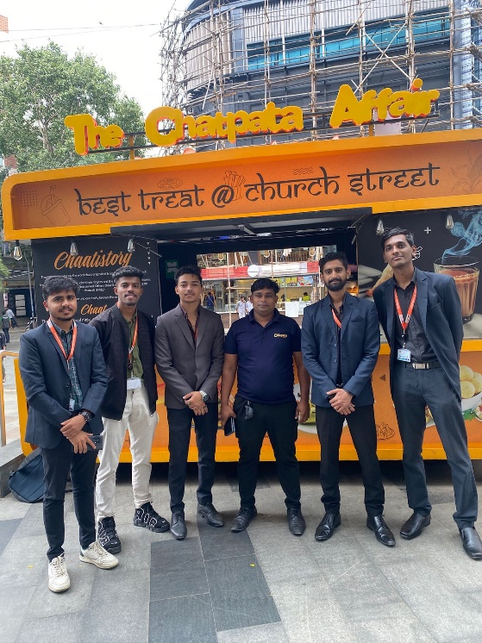
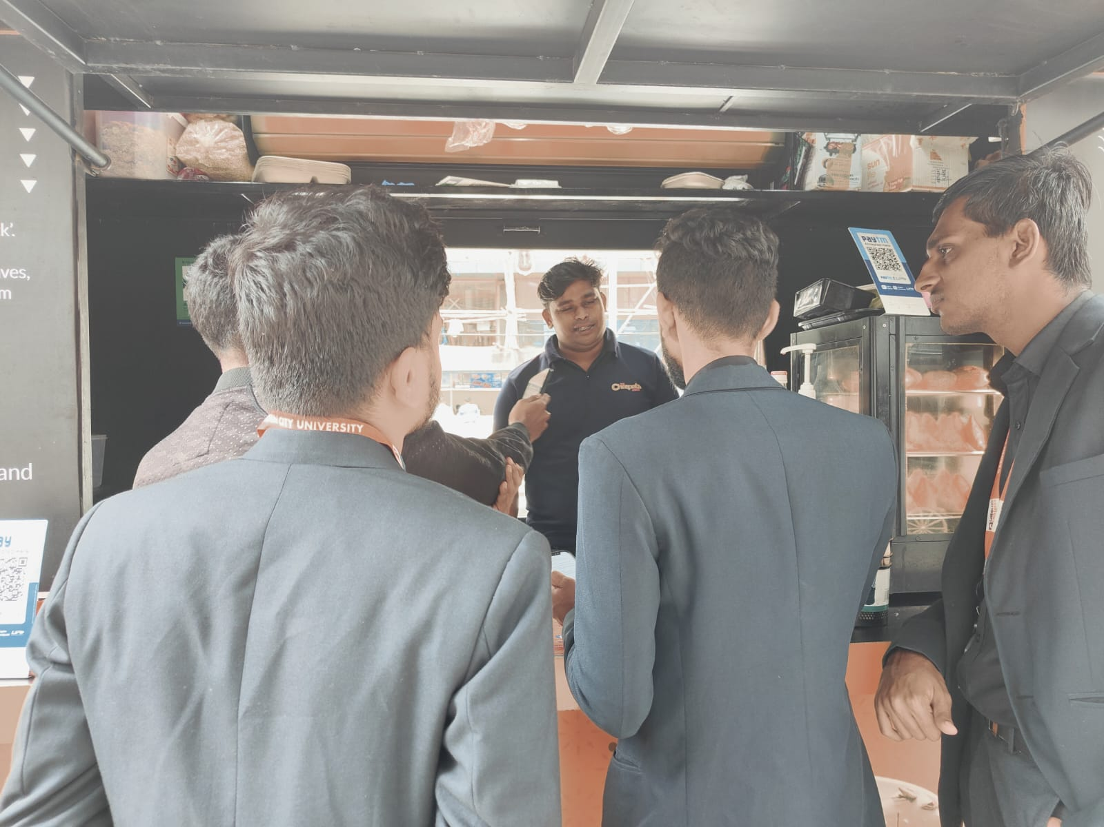
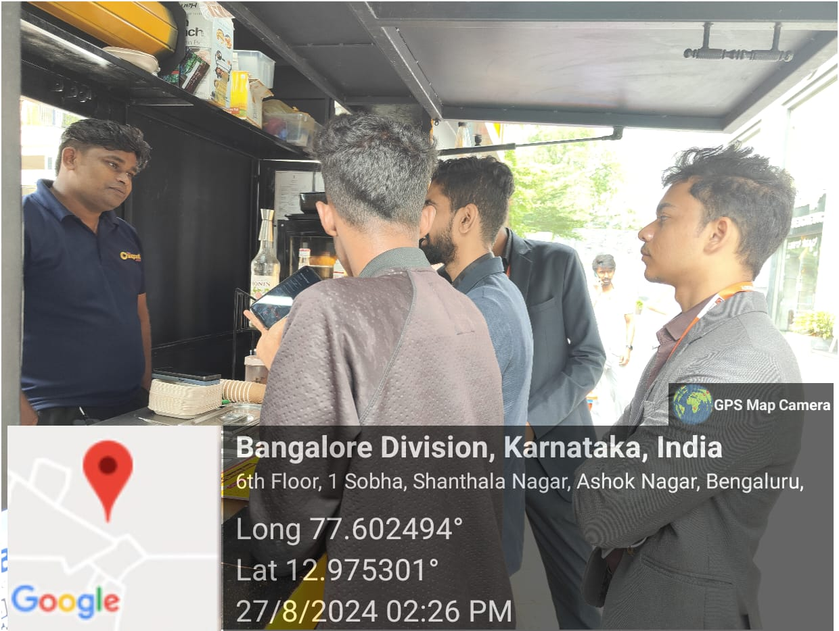
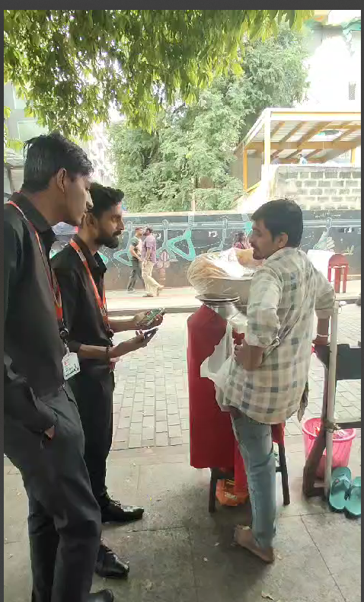

Slide 13
THANK YOU!

